Slide 1
The Rise of the Third Wave Coffee Movement: Coffee Shops in Portland vs Hillsboro
Capstone Project – The Battle of Neighborhoods
Applied Data Science Capstone

Slide 2


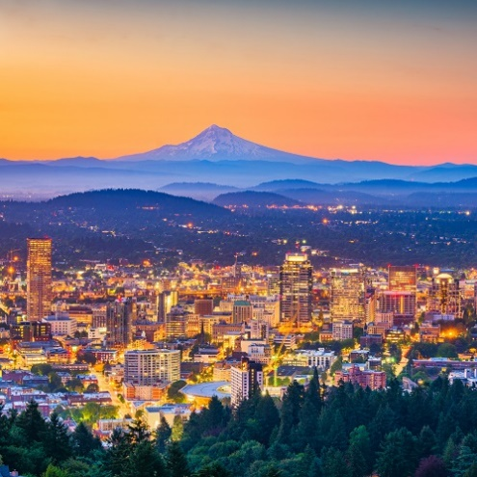
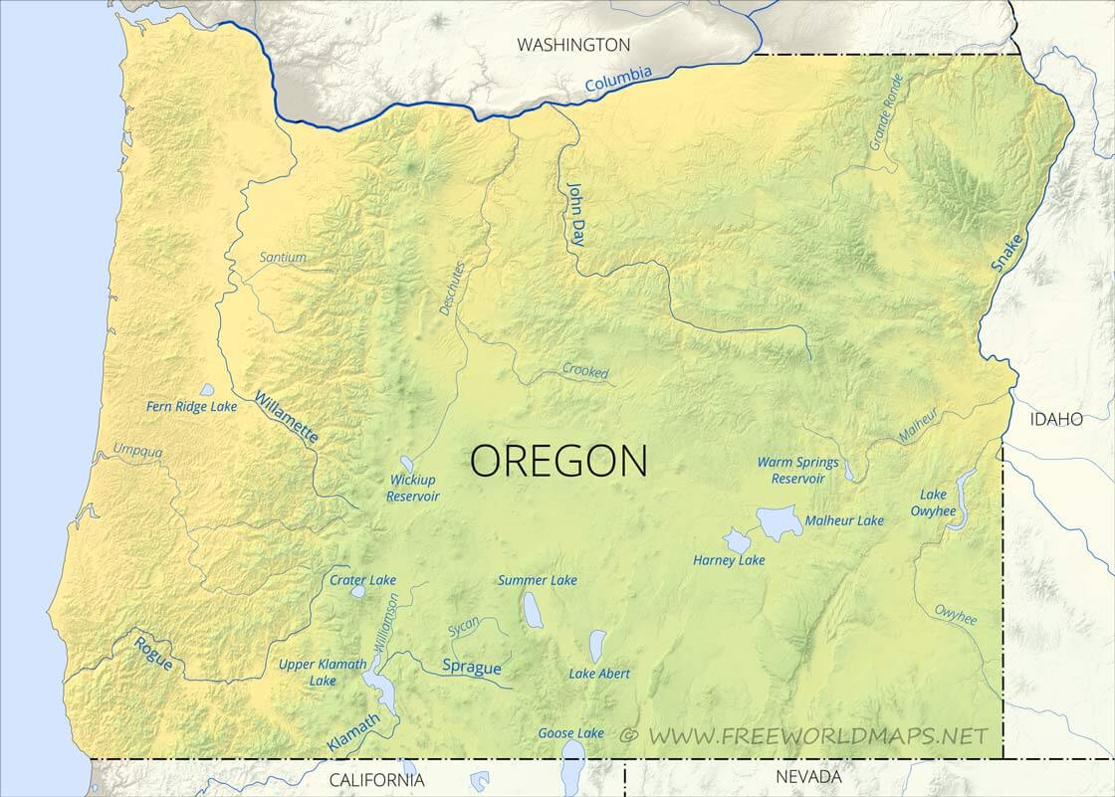
Introduction
Oregon is a good place to live: diverse nature sites to visit, good paying jobs, family friendly cities
Third wave coffee movement is where people to not only consume coffee but also to “experience” coffee. This movement is making its way to US and especially to Oregon.

Slide 3

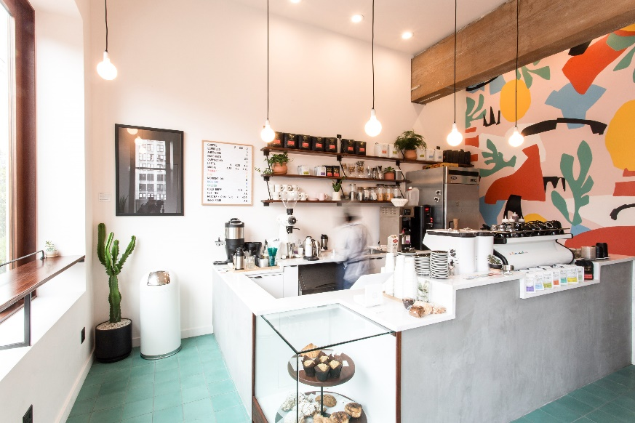
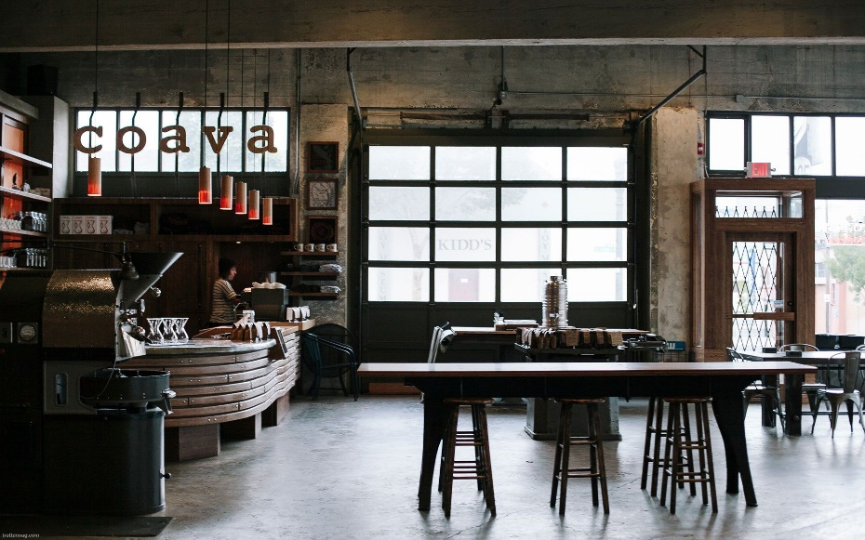
Objective
Analysis of coffee shops in Portland and Hillsboro
Finding a new potential location for the investors to open up a new third wave coffee shop

Slide 4
Data and Methodology
Median household income in Portland and Hillsboro, can be obtained from datausa.io/profile/geo
Venues location from Foursquare API and rank them based on the venues count. Finding the number of coffee shops in Portland and Hillsboro
Map visualization using Folium in order to estimate the next potential location for opening up a new coffee shop

Slide 5
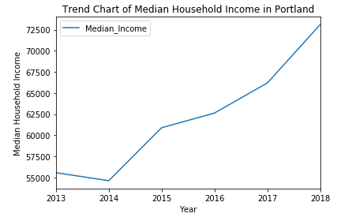
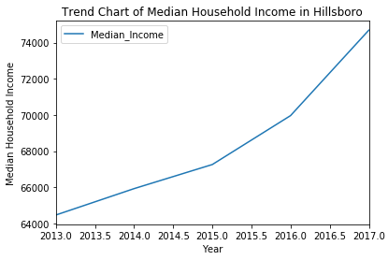
Results
The median household income in Portland is 73,097 USD
The median household income in Hillsboro is 75,599 USD

Slide 6
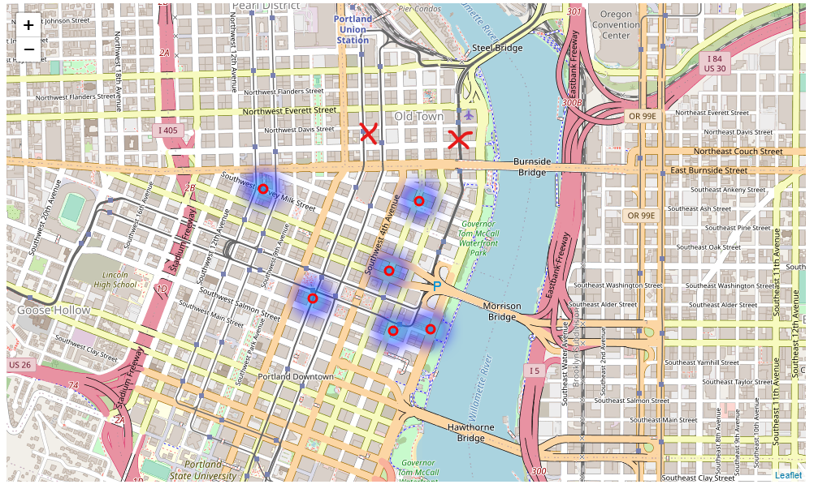
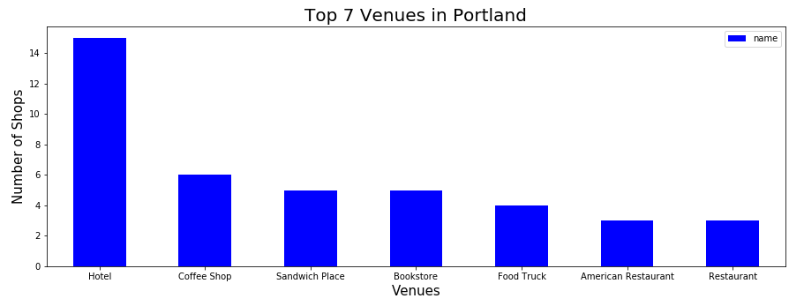
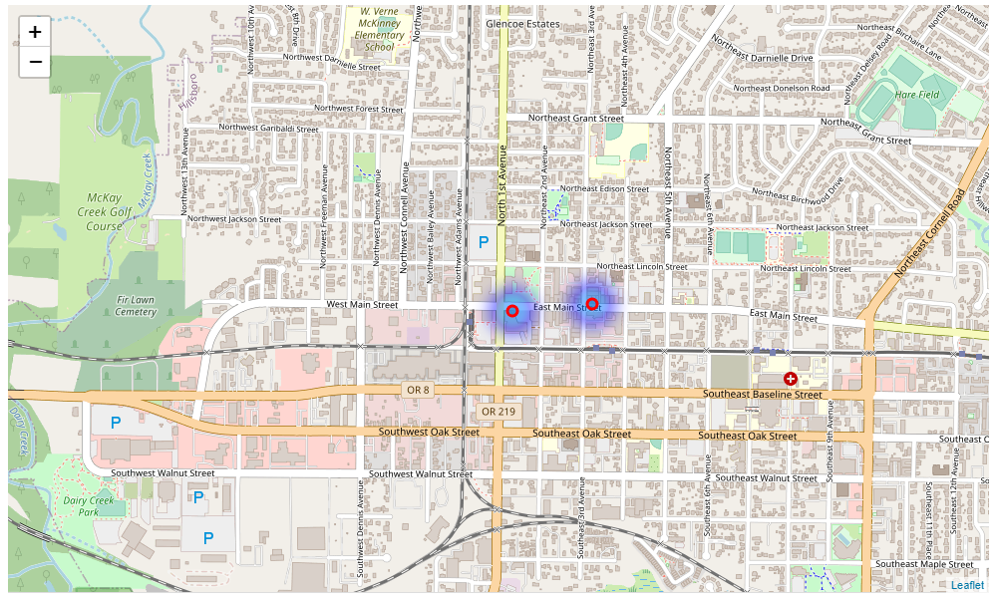
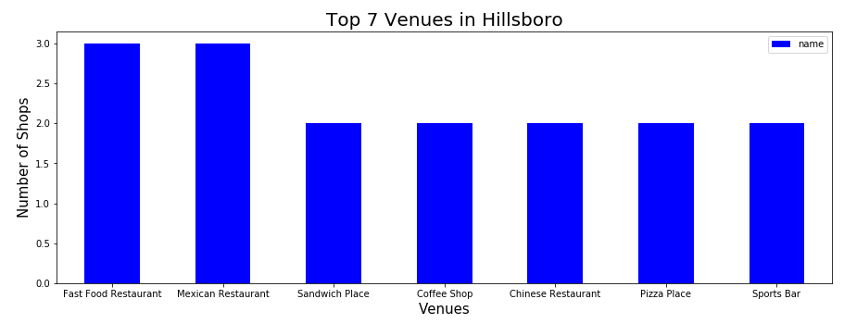
Results
Here is the visual map where the current coffee shops are located in Portland. Red X marks are the suggested new locations for investors and stakeholders.
6 coffee shops in Portland
2 coffee shops in Hillsboro
Coffee shops location in Hillsboro

Slide 7
Conclusion
Both Portland and Hillsboro are still good investment for opening up a new third wave coffee shop for their own reasons
Portland has the city vibrant and it is the ideal spot for people to hang out from all over the cities in Oregon state. The suggested location will be around ‘Old Town’ and ‘Northwest Davis Street’ area.
Hillsboro can be a good alternative city if we are looking for somewhere quieter and closer to housing area. Furthermore, the city has higher household income, and less competitor than Portland.

Slide 8
Thank you!

